Slide 1
Chapter 8: Relational Database Design- Functional Dependencies
Notes:
1

Slide 2
Lossless-join Decomposition
For the case of R = (R₁, R₂), we require that for all possible relations r on schema R
r = ∏_{R1} (r ) ∏_{R2} (r )
A decomposition of R into R₁ and R₂ is lossless join if at least one of the following dependencies is in F⁺:
R₁ ∩ R₂ → R₁
R₁ ∩ R₂ → R₂
The above functional dependencies are a sufficient condition for lossless join decomposition; the dependencies are a necessary condition only if all constraints are functional dependencies
Notes:
2

Slide 3

Example
R = (A, B, C) F = {A → B, B → C)
Can be decomposed in two different ways
R₁ = (A, B), R₂ = (B, C)
Lossless-join decomposition:
R₁ ∩ R₂ = {B} and B → BC
Dependency preserving
R₁ = (A, B), R₂ = (A, C)
Lossless-join decomposition:
R₁ ∩ R₂ = {A} and A → AB
Not dependency preserving (cannot check B → C without computing R₁ R₂)
Notes:
3

Slide 4
Dependency Preservation
Let F_{i} be the set of dependencies F ⁺ that include only attributes in R_{i}.
A decomposition is dependency preserving, if
(F₁ ∪ F₂ ∪ … ∪ F_{n} )⁺ = F ⁺
If it is not, then checking updates for violation of functional dependencies may require computing joins, which is expensive.
Notes:
4

Slide 5
Testing for Dependency Preservation
To check if a dependency α → β is preserved in a decomposition of R into R₁, R₂, …, R_{n} we apply the following test (with attribute closure done with respect to F)
result = α while (changes to result) do for each R_{i} in the decomposition t = (result ∩ R_{i})⁺ ∩ R_{i} result = result ∪ t
If result contains all attributes in β, then the functional dependency α → β is preserved.
We apply the test on all dependencies in F to check if a decomposition is dependency preserving
This procedure takes polynomial time, instead of the exponential time required to compute F⁺ and (F₁ ∪ F₂ ∪ … ∪ F_{n})⁺
Notes:
5

Slide 6
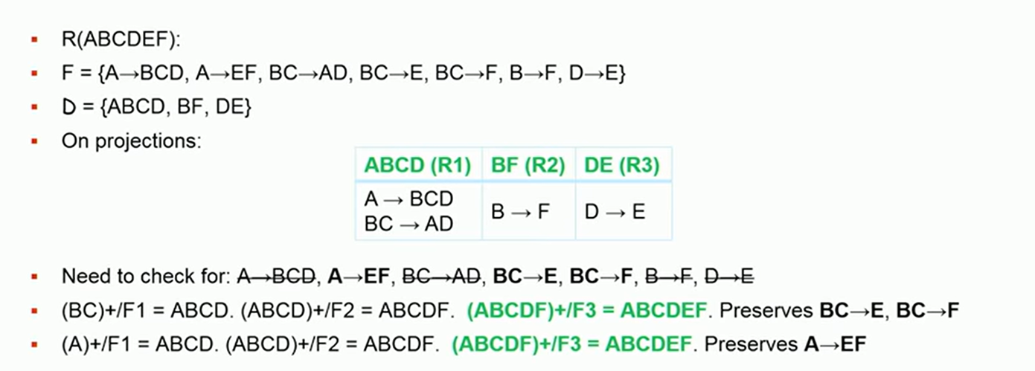
Example

